Slide 1
Chord Recognition
Mattia lecci
Federico mason
Victor Cercos Llombart

Slide 2
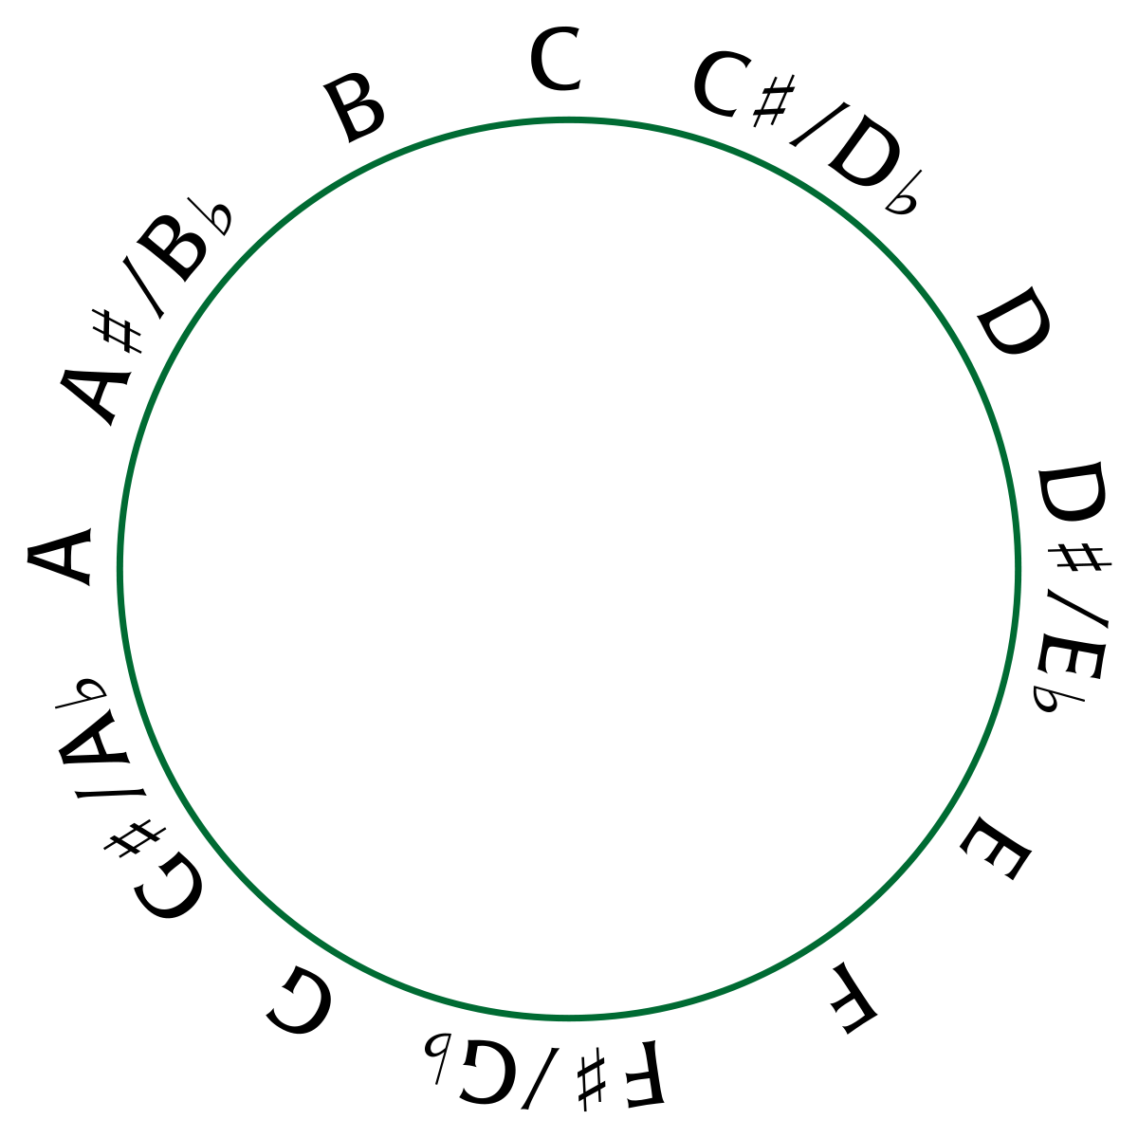
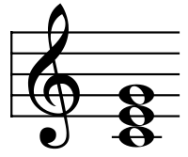

Introduction

Slide 3
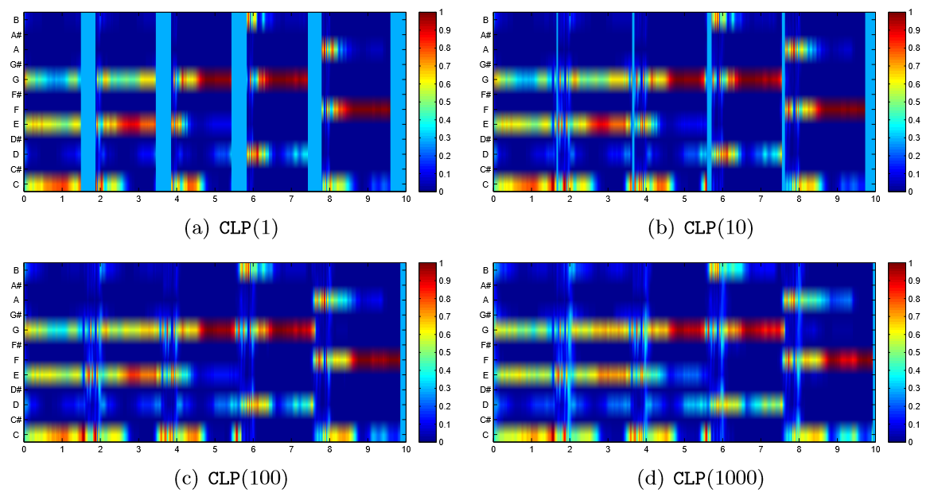
Feature Extraction: CLP (I)
Chroma Features with Logarithmic Compression:
Pitch Decomposition
Spectral Pooling
Normalisation
$$\log\left(η·e+1\right)$$
log⁡(𝜂·𝑒+1)
1
2
3
4

Slide 4
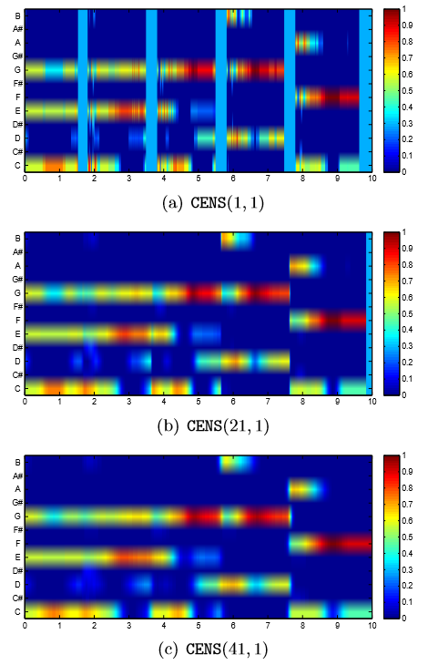
Feature Extraction: CENS (II)
Chroma Energy Normalized Statistics:
Normalisation
Normalisation
Smoothing
Downsampling
Quantisation
1
2
3
4
5

Slide 5
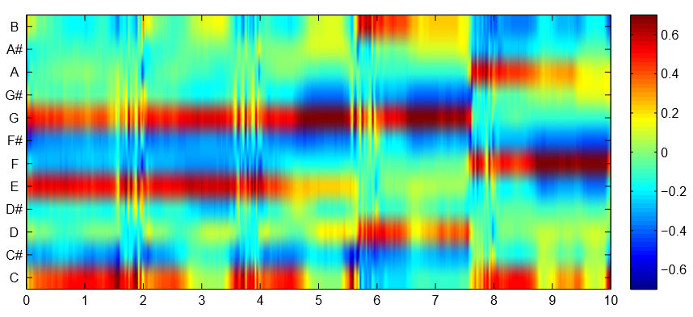
Feature Extraction: CRP (III)
Chroma DCT-Reduced log Pitch:
Log Compression
Chroma Projection
Filtering
Inverse DCT
DCT Transformation
1
2
3
4
5

Slide 6

PART I: Single Chord Recognition

Slide 7
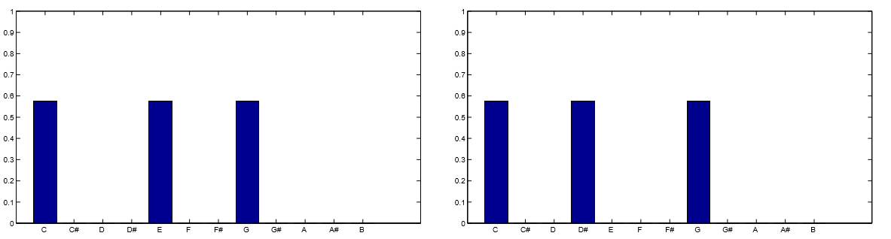
Template Based: Binary Templates (I)
C-Major
C-Minor

Slide 8
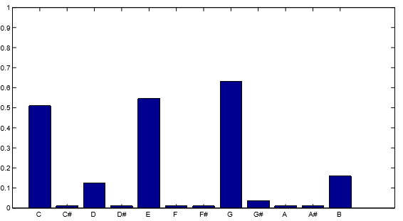
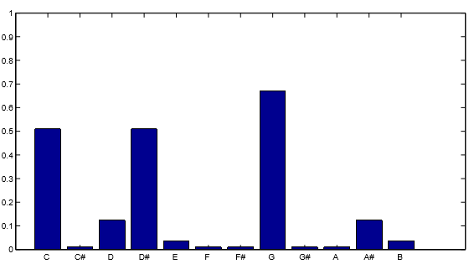
Template Based: Harmonic Templates (II)
6 Harmonics Calculation
Normalization
s-Factor Calculation
1
C-Major
2
C-Minor
3

Slide 9
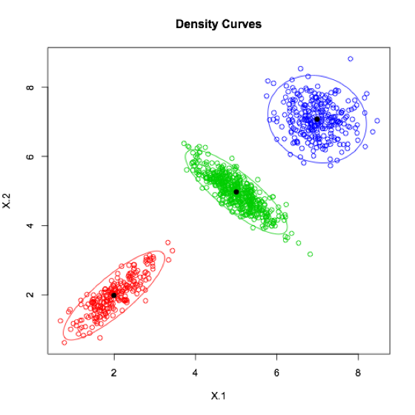
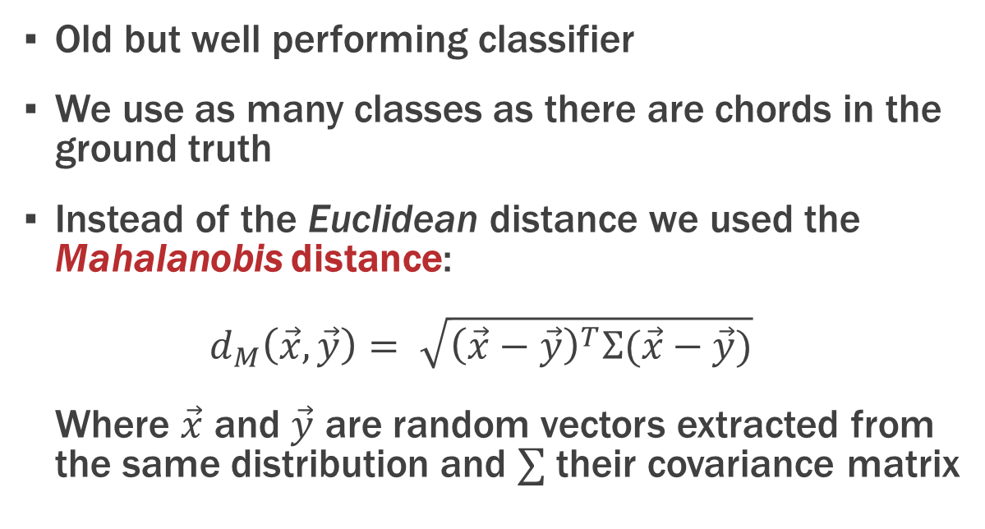
Feature Classification (I)
Gaussian Mixture Models (GMMs)
Old but well performing classifier
We use as many classes as there are chords in the ground truth
Instead of the Euclidean distance we used the Mahalanobis distance: $d_{M}\left(\vec{x},\vec{y}\right)= \sqrt{{\left(\vec{x}−\vec{y}\right)}^{T}Σ(\vec{x}−\vec{y})}$ Where $\vec{x}$ and $\vec{y}$ are random vectors extracted from the same distribution and $∑$ their covariance matrix

Slide 10
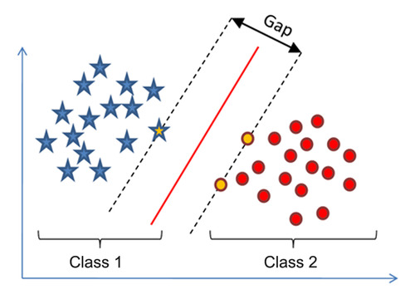
Feature Classification (II)
Multiclass Support Vector Machines (MC-SVM)
Multiclass generalization of SVMs using Error Correcting Output Codes (ECOC)
Still as powerful as binary SVM
It’s still possible to use non linear kernels
Even more hyperparameters given by ECOC system

Slide 11
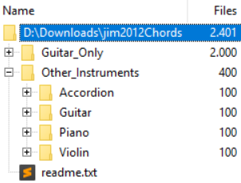
Experiment Setup (I)
We use the database jim2012Chords:
Over 2,000 audio tracks of single chords
Isolated instruments: guitars (different types), piano, violin, accordion
Both noise-free and noisy environments
Both major and minor triads (chords involving 3 notes)

Slide 12
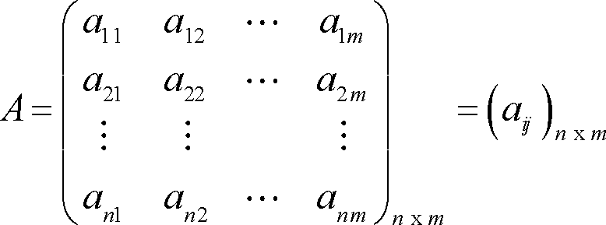
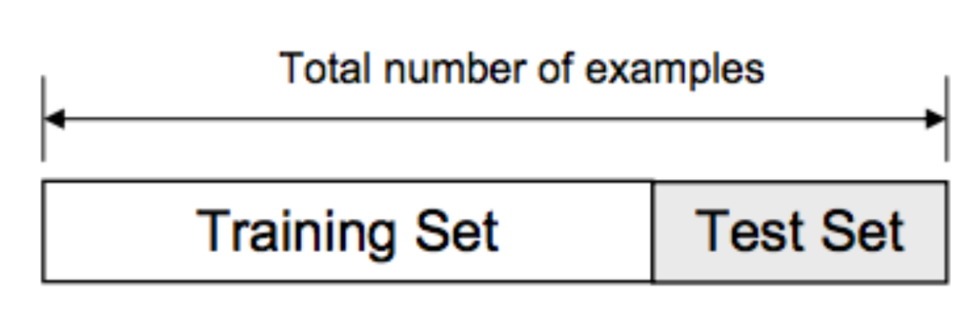
Experiment Setup (II)
Procedure
We extract the features from each track (12xN matrix, where N is the number of frames)
We take the maximum value along the second dimension and renormalize to unit L2 norm
Why? Because we’re interested in peaks
We split the dataset into 70% training and 30% testing

Slide 13
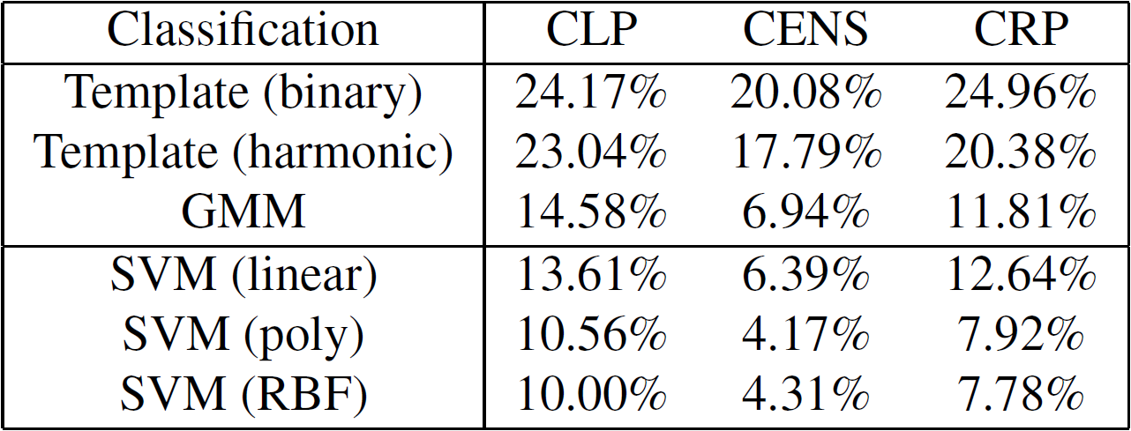
Results

Slide 14
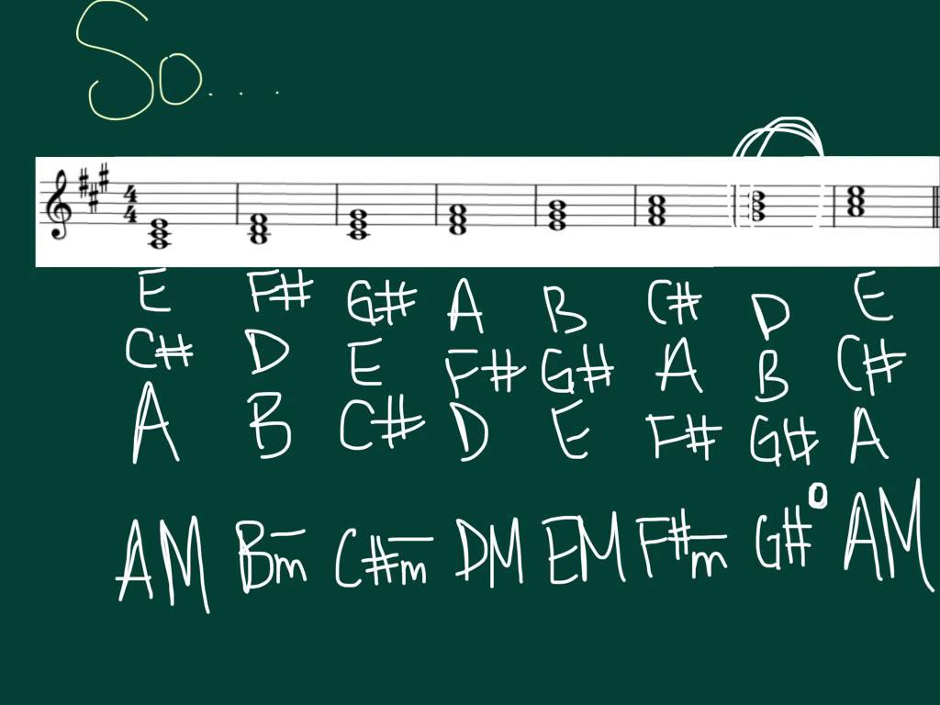
PART II: Full Song Chord Recognition

Slide 15
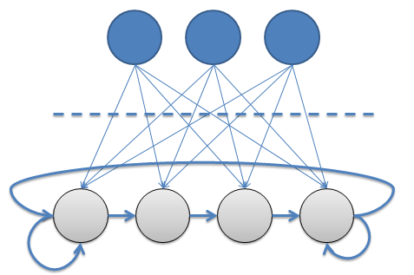
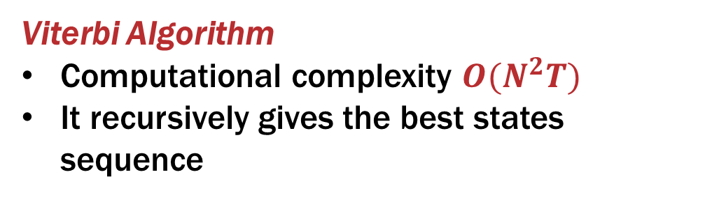
Hidden Markov Models (HMMs)
Extensionof classical Markov Models
They can be seen as a pair of stochastic processes, one observable
and one hidden
They are defined by
Emission probabilities
Transition probabilities
Starting probabilities
Viterbi Algorithm
Computational complexity $O(N^{2}T)$
It recursively gives the best states sequence

Slide 16
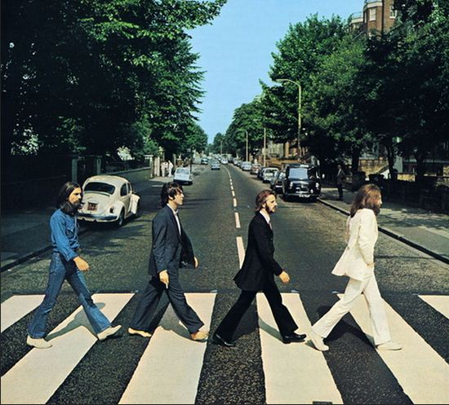
Experiment setup: dataset (I)
The Beatles’ dataset, transcripted by Christopher Harte
We needed to make some changes
We choose 150 songs out of 180
We mapped Harte’s labels into 30 labels (chromatic scale, minor and major chords
The experiment is split in three phases: pre-processing, training and testing

Slide 17
Experiment setup: pre-processing (II)
We divide the original dataset in a training set and a testing set
Thanks to Chroma toolbox we got frame-features
Thanks to Harte’s work we got period-labels
We needed to adapt the two kind of results: at the end we obtained for each song a sequence of frame-features and a sequence of frame-labels

Slide 18

Experiment setup: training (III)
The training features allowed us to:
Build SVM with a polynomial kernel
Get emission probabilities for HMM
The training labels allowed us to:
Get transition probabilities for HMM
Get starting probabilities for HMM

Slide 19

Experiment setup: testing (IV)
The testing song are first processed only with SVM, then also with HMM (thanks to Viterbi algorithm)
We got two different results
Before HMM processing
After HMM processing
Did we get improvements?

Slide 20
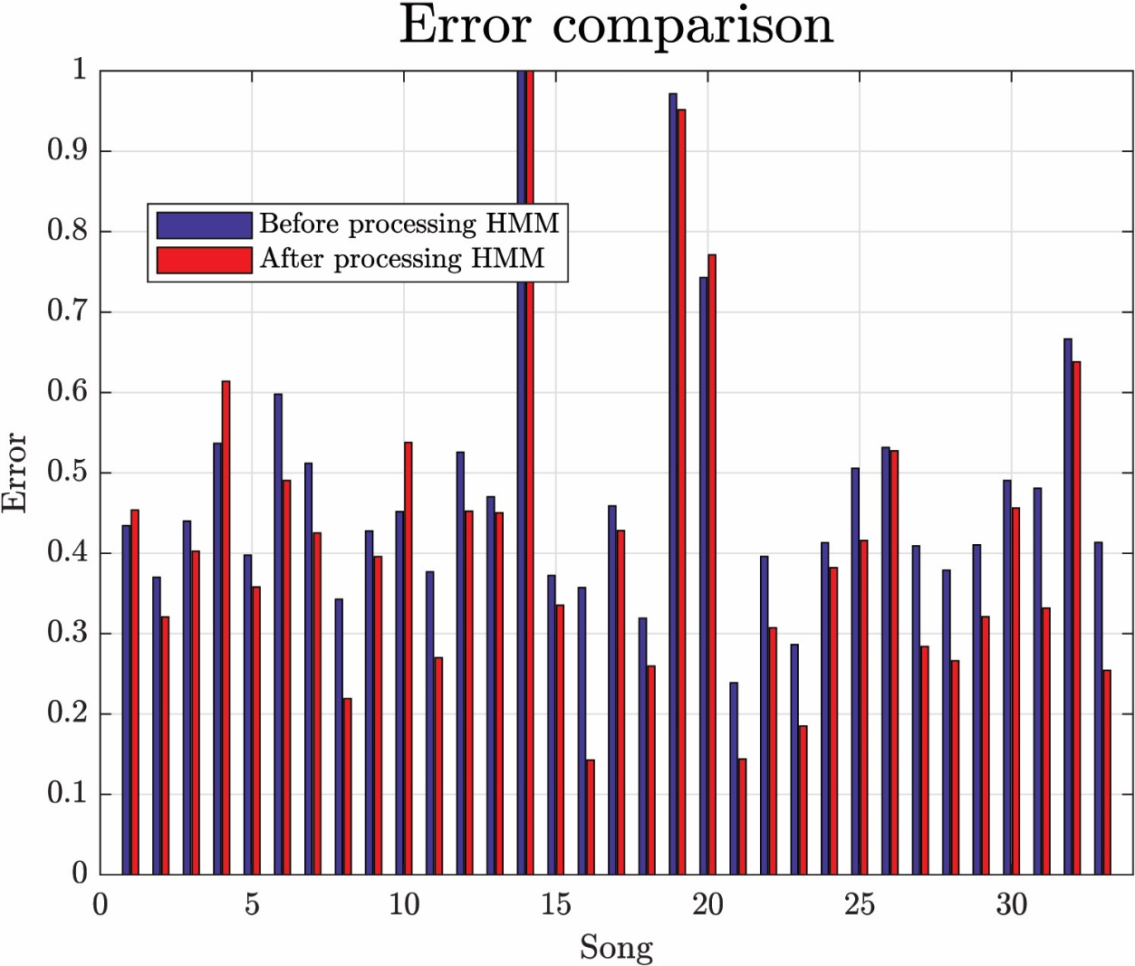
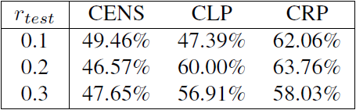
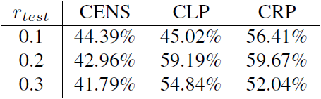
Results
HMM does always improve results on average
It doesn’t do it for each song singularly
It does always improve song smoothing
Before HMM
After HMM

Slide 21
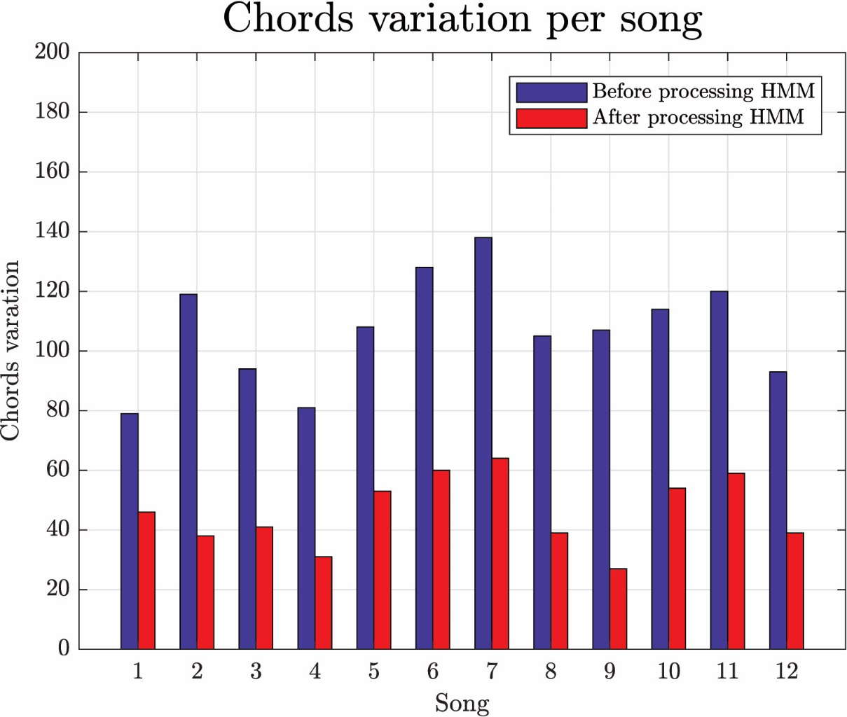
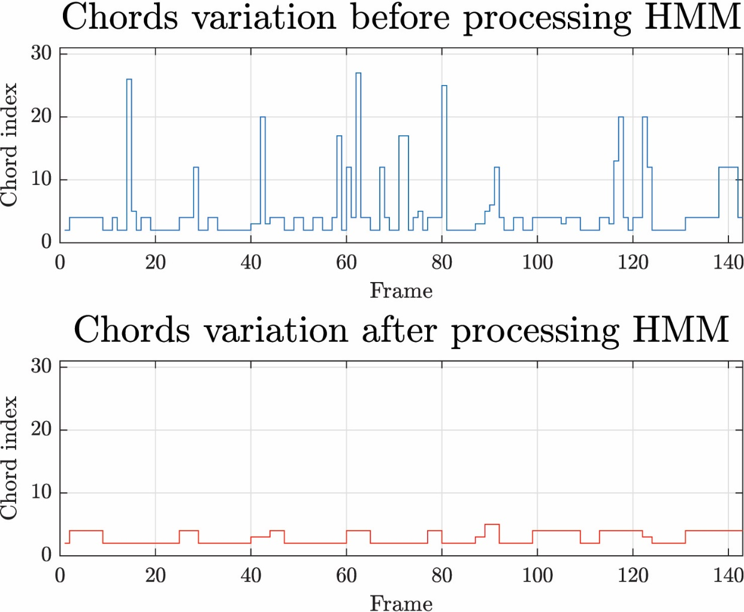
Chord variation analysis

Slide 22
Conclusions

Slide 23
Conclusions
CENS greatly overperform all the other features
Template-based methods are too simple to obtain decent results
SVMs with non-linear kernels outperform the other classifiers
HMM help a lot smoothing the estimates and improves accuracy
Future work:
More feature extraction mechanisms and ECOC hyperparameters could be explored
More modern classifiers
Extract/Subtract specific instruments

Slide 24

Thanks for your attention

